Slide 1

W
L
O
E
E
C
M

Slide 2
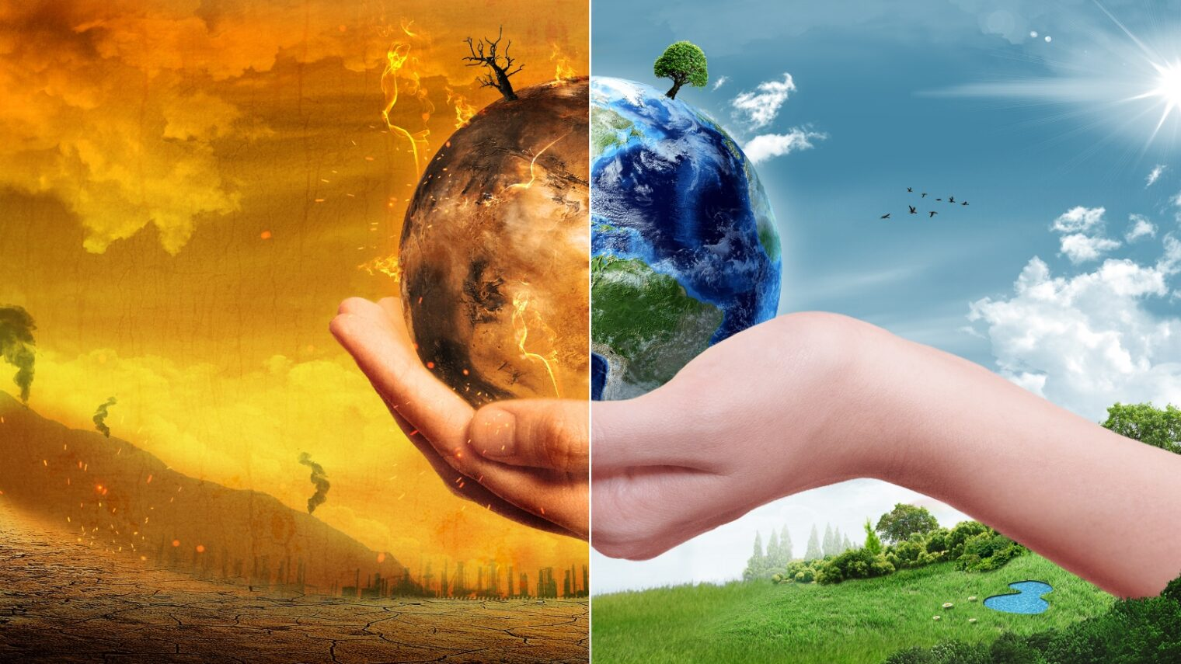
CLIMATE CHANGE &
GLOBAL WORMING
Prepared By
Md. Ruyel Rahman

Slide 3


Slide 4
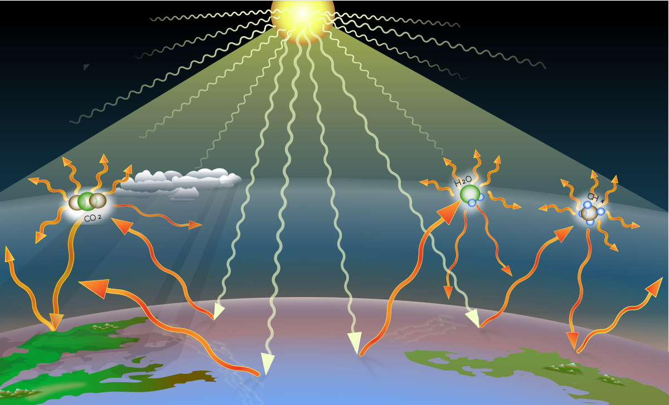
Sourcese of Greenhouse Gas

Slide 5
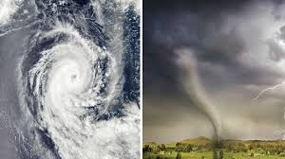
Effect Of Climate Change
HURRICAN
A hurricane is a huge organized thunderstorm complex that develops the ocean
The ingredients are warm ocean water , weak upper level winds, and low pressure
TORNADOES
A tornado is rapidly spinning air that develops from a thunderstorms and is on the ground.
The ingredients for a tornado are a thunderstorm , winds changing speeds with height and rapidly rising air.

Slide 6
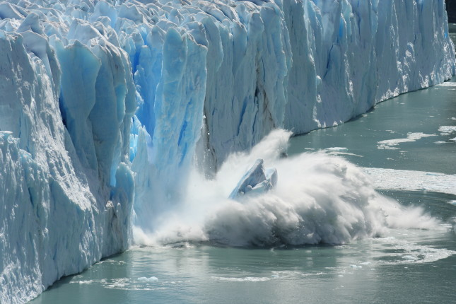
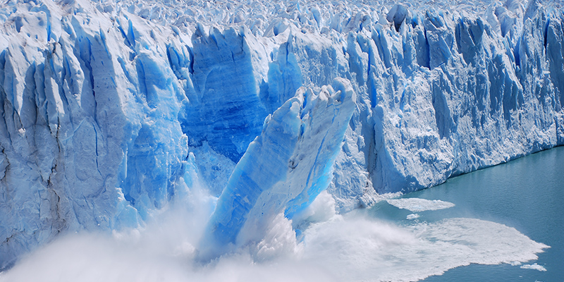
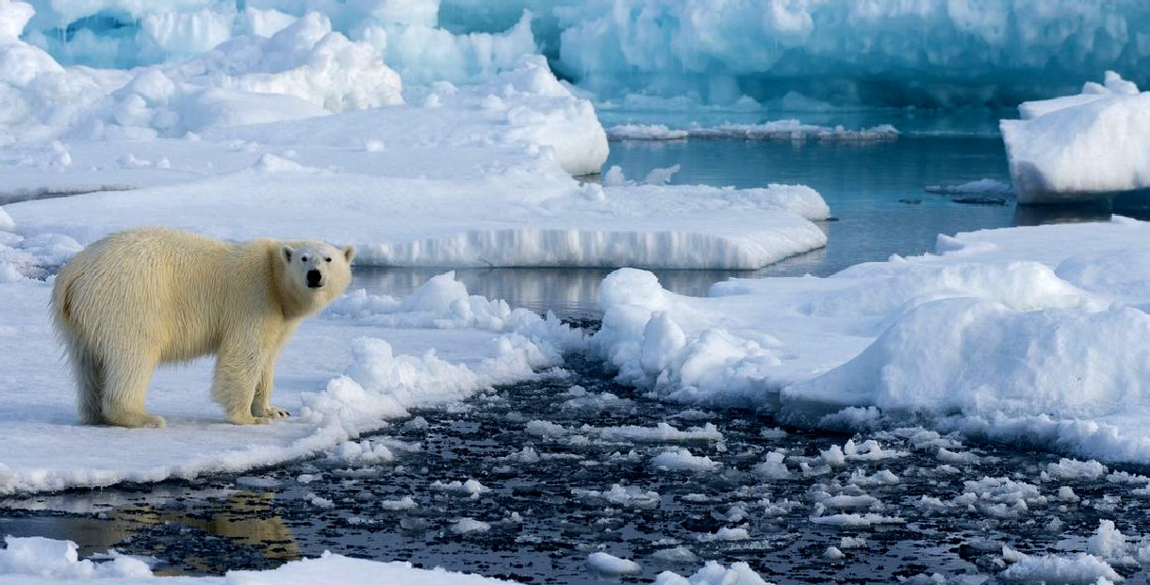
MELTING OF GLACIERS

Slide 7
Climate change
Raising sea level
Loss Biodiversity
Ocean Acidification
Change ecosystem
Increasing Wildfires

Slide 8

THANK YOU

